Slide 1
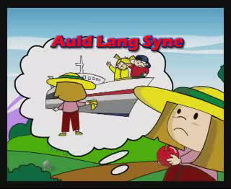

Slide 2
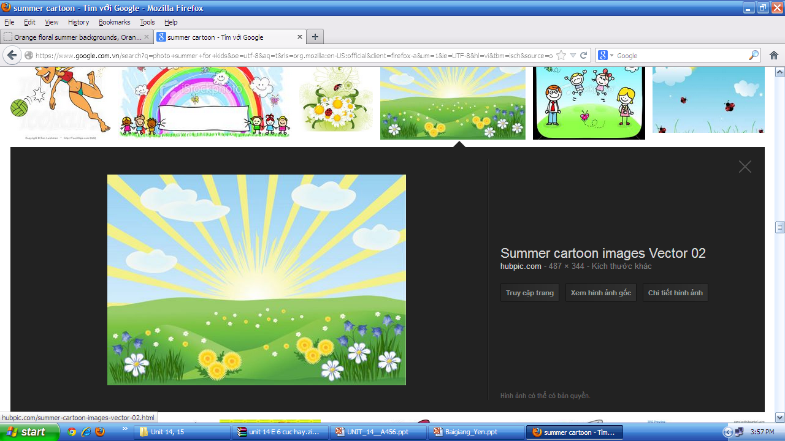






Welcome to English class !
Teacher: Le Minh Phuong

Slide 3
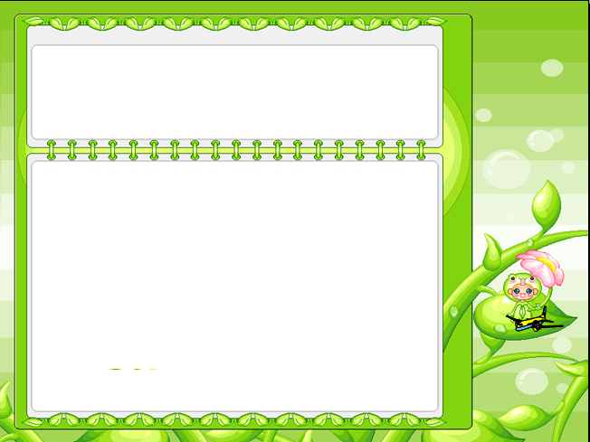
GUESSING GAME

Slide 4
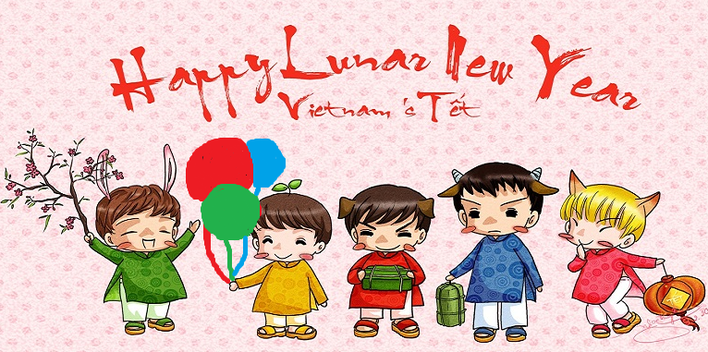

?2
?1
?3
?4

Slide 6

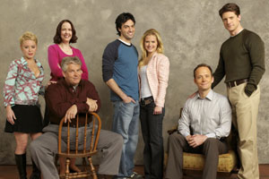
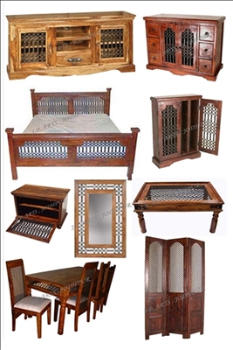
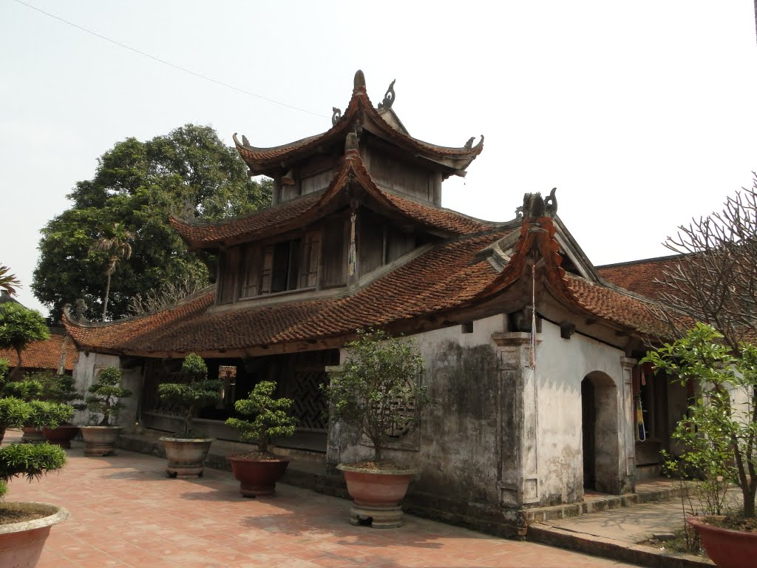
New words
1. (a) relative
2. furniture (unc)
3. (a) calendar
4. (a) pagoda
5. (to) hang

Slide 7


Listen and repeat

Slide 8
Listen and repeat
a.wish
b.fireworks
c.furniture
d.present
e.shopping
f.tree
g.flower
h.relative
i.pagoda
j.calendar
k.special food

Slide 9
Matching
a wish
clean
make
do
a calendar
the shopping
a pagoda
visit
relatives
trees
give
go to
the furniture
plant
clean

Slide 10

go to
a pagoda
give
lucky money
make
a wish
hang
a calendar
watch
fireworks
do
the shopping
cook
special food
visit
relatives
clean
the furniture
decorate
our house
plant
trees
buy
peach blossoms

Slide 11


Lucky Money
1
3
1
6
5
7
8
4
2
go to a pagoda
give lucky money
cook special food
decorate the house
buy peach blossoms
watch fireworks

Slide 12

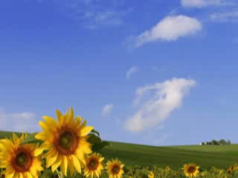

Pronunciation
/ʃ/
Wish
/s/
Spring

Slide 13
Practice
Celebrate
School
Special
She
Shopping
Spring
Blossoms
Should
Summer
Wish
Rice
Rubbish
/s/
/ʃ/

Slide 14


Listen and tick
/ʃ/ | /s/
1. We come home every summer.
s
2. We should leave early.
sh
3. I will make a wish.
sh
4. I’m second in my class.
s
ss
sh
5. My mother goes shopping every day.
s
6. This is a small garden.
7. Spring is coming.
S

Slide 15

Listen and practice
Spring is coming!
Tet is coming
She sells peach blossoms
Her cheeks shine
Her eyes smile
Her smile is shy
She sells peach blossoms
S
Sh
s
ss
sh
s
s
sh
Sh
s
ss

Slide 16
Choose the best answer
1. What is your lesson about?
A. New Year | B. Things and activities for Tet | C. Food for Tet holiday | D. Songs about Tet holiday
2. Which sounds do you learn?
A. /s/ | B. /z/ | C. /ʃ/ | D. /s/ and /ʃ/
3. Which verb often goes with “Fireworks”?
A. cook | B. watch | C. plant | D. clean

Slide 17


HOMEWORK
Learn by heart and write new words (3 lines)
Make sentences using the phrases in EX3 (p.60) textbook
Do exercises: in WB

Slide 18


Slide 19
Best wishes to all of you.
Good bye. See you soon.

Slide 20


It is the beginning month of a year

Slide 21

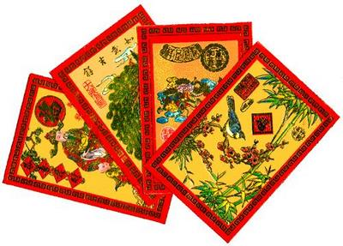

The children like to get from their parents
on Tet holiday for luck.

Slide 22

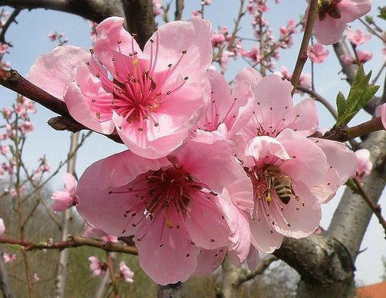
It’s the traditional flower at Tet in Northern of Viet Nam

Slide 23

People like to watch them on New Year’s Eve.

Slide 24
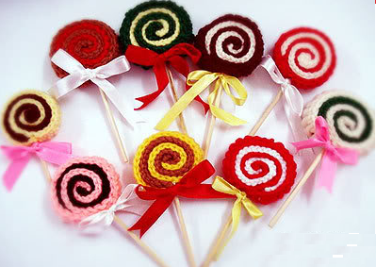
You are so lucky !

Slide 25


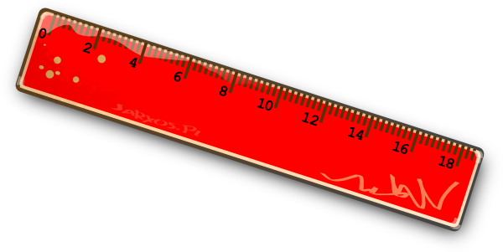
How lucky you are !

Slide 26


Slide 27


